Slide 1

Rockbuster Stealth Data Analysis Project
By Esther Howard

Slide 2
Introduction

Slide 3


Rockbuster Stealth LLC is a movie rental company that used to have stores around the world.
Facing stiff competition from streaming services such as Netflix and Amazon Prime, the Rockbuster Stealth management team is planning to use its existing movie licenses to launch an online video rental service in order to stay competitive.

Slide 4

Agenda
01.
02.
03.
04.
Movies
Countries
Rentals
Summary
04.
Recommendations

Slide 5

Movies
01.

Slide 6

Movies Overview
1000 films
1 language
17 genres
5 ratings

Slide 7

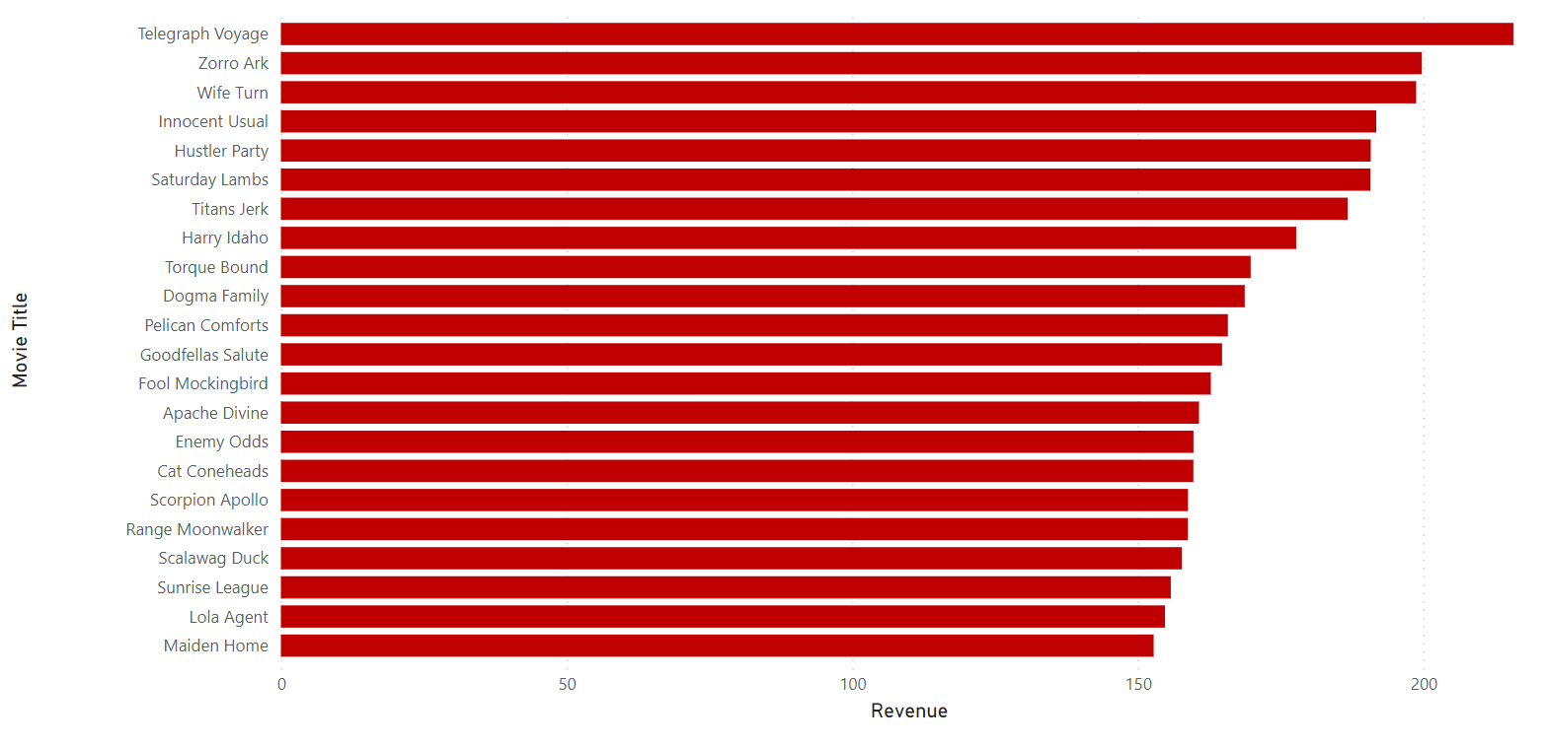
Revenue generated by movie title

Slide 8
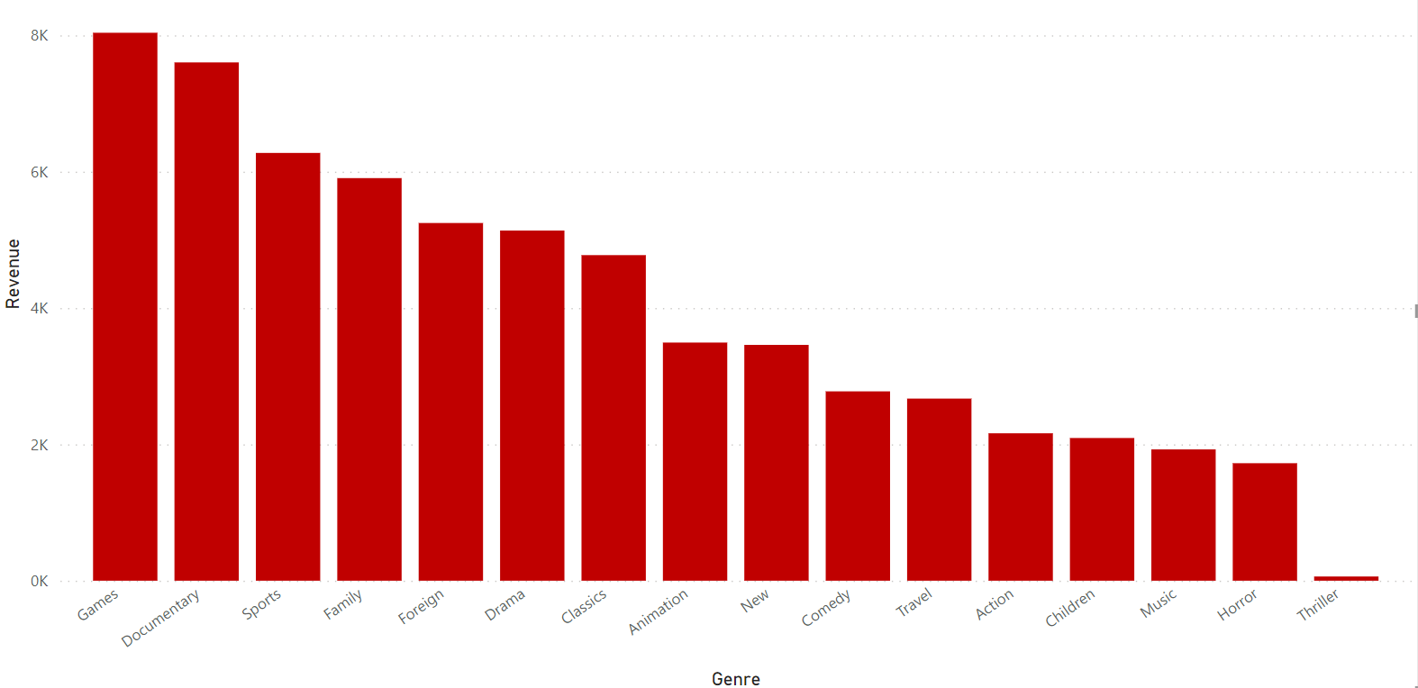
Revenue generated by genre

Slide 9
Countries
02.

Slide 10
Countries Overview
108 countries
200 cities

Slide 11
Customers by country
Country | Percentage of customers
China | 10%
India | 9%
Mexico | 6%
United States | 5%
Japan | 5%
Russia | 4%

Slide 12
Customers by country
6
40%
Revenue
Countries

Slide 13
Customers by city
Country | Number of customers
Aurora, USA | 2
Jurez, Mexico | 1
Ljubertsy, Russia | 1
Changzhou, China | 1
Meixian, China | 1
Xintai, China | 1

Slide 14
Rentals
03.

Slide 15
Rental Overview
$2.98
$4.20
Average Rental Rate
Average Transaction Value
5 days
$102
Average Rental Duration
Average Revenue by Customer
$61,312.04
Total Revenue

Slide 16
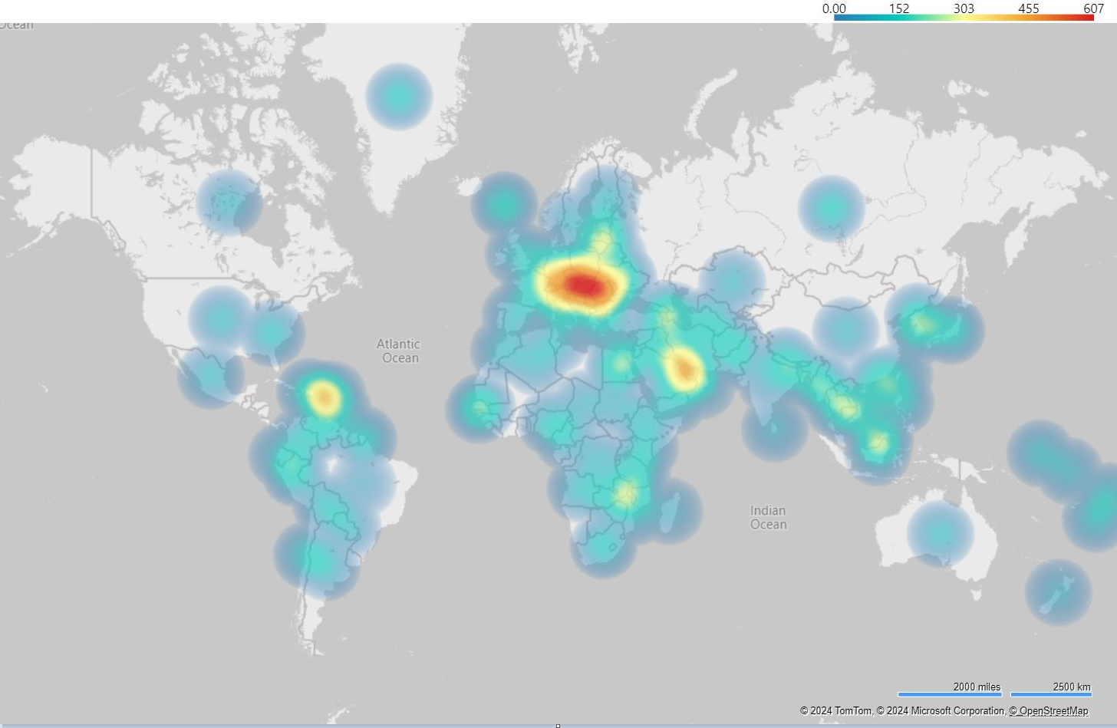
Revenue generated by country

Slide 17
Top customers by Lifetime Value
Country | Number of rentals | Value
Eleanor Hunt - Runion | 45 | 211.55
Karl Seal – USA | 42 | 208.58
Marion Snyder – Brazil | 39 | 194.61
Rhonda Kennedy – Netherlands | 38 | 191.62
Clara Shaw – Belarus | 40 | 189.6
Rommy Collazo - Iran | 37 | 183.63
24.37
102.36
Average number of rentals by customer
Average lifetime value by customer

Slide 18
Summary
04.

Slide 19
Summary
Top movies by revenue
- Telegraph Voyage
- Zorro Ark
- Wife Turn
Top genres
- Games
- Documentary
- Sports

Slide 20
Summary
1000 films
17 genres
UAE, Egypt, Hong Kong, Romania and Ukraine are the countries with more sales
China, India, Mexico, USA and Japan are the countries with more customers
$2.98
Average Rental Rate
$4.20
Average Transaction Value

Slide 21
Recommendations
05.

Slide 22

Recommendations
Add movies to inventory in other languages
Conduct surveys to explore other titles of interest by customers
Pricing strategy depending on location. This will differenciate between:
Monthly subscription ($5.99 to $12.99/month)
Pay per view movie at a higher cost ($2.99 to $4.99/movie)
Start marketing campaign to announce changes to current customers at promotional rate.
Soft launch of the streaming service recommended in China and UAE, other regions to follow.
Conduct further data analysis as needed by region.

Slide 23
Questions?

Slide 24

Thank you
Queries and visualizations on Power BI can be found here
CREDITS: Slidesgo, Flaticon & Freepik

